Slide 1

FRONT-END
WEB DEVELOPMENT

Slide 2


JavaScript & JQuery

Slide 3


What is JavaScript?
JavaScript is a powerful and popular language for programming on the web.

Slide 4

What is JQuery?
jQuery is a fast, small, and feature-rich JavaScript library. It makes things like HTML document traversal and manipulation, event handling, animation, and Ajax much simpler with an easy-to-use API that works across a multitude of browsers.
Download jquery: https://code.jquery.com/jquery-3.2.1.min.js
Selector . Event . function{};
Selector can be:
id: $("#id");
class: $(".class");
tag: $("body");
$("div");
$("p");
Event can be:
.click()
.dblclick()
.mouseenter()
.mouseleave()
..
..
etc

Slide 5

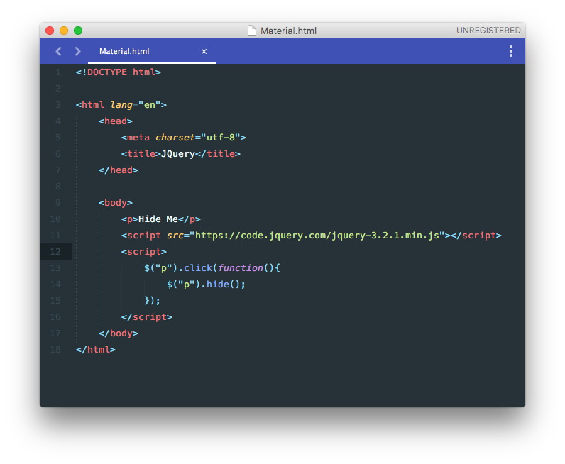
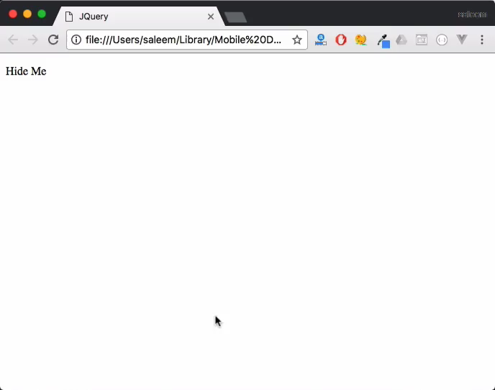
.Click() & .hide()

Slide 6
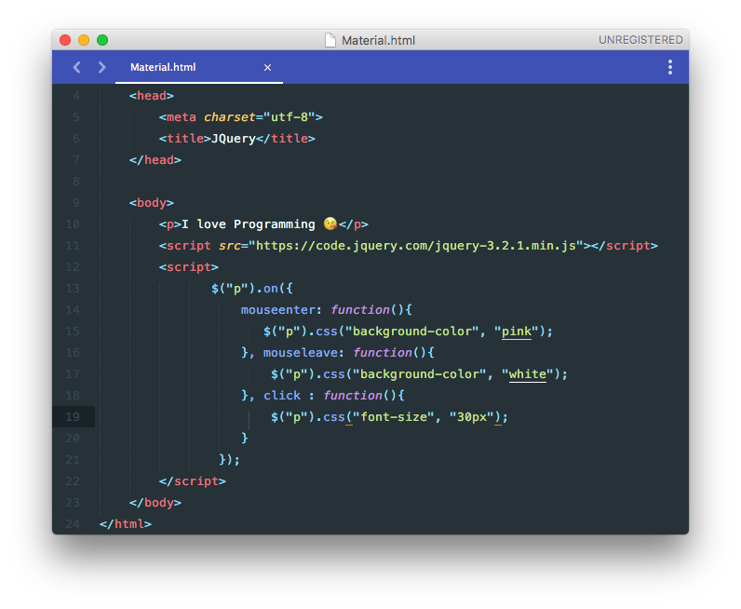
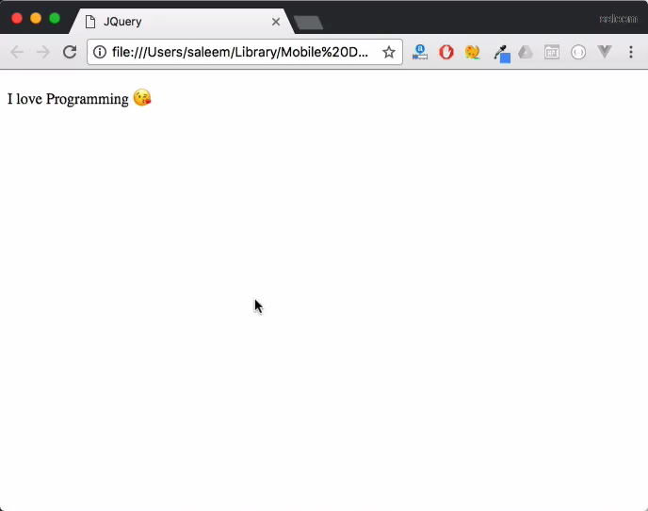
.on() & .CSS()
The on() method attaches one or more event handlers for the selected elements.
jQuery’s css() method is used to set or change values of the css properties.

Slide 7

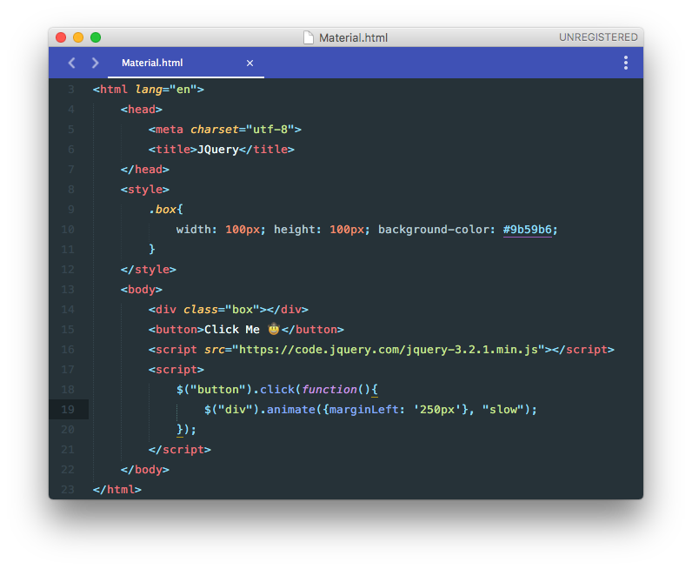
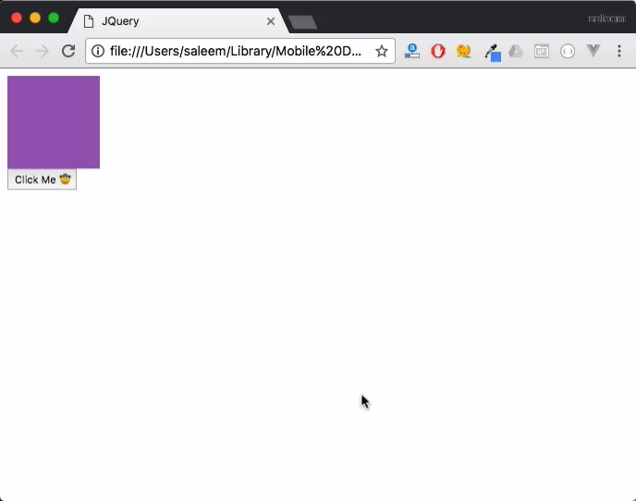
.animate()
The general usage of animate() works very similarly to the css() method:
it takes an object of properties and values to set.
The second parameter is the time it takes to animate the properties. The third is a callback function

Slide 8
hide(), show() & Sliding
$(selector).hide(speed,callback);
$(selector).show(speed,callback);
$(selector).toggle(speed,callback);
$(selector).slideUp(speed,callback);
$(selector).slideDown(speed,callback);
$(selector).slideToggle(speed,callback);
All of them are just shortcuts of animate function.

